Slide 1
Gradient Descent vs Simulated Annealing on Rastrigin
Comparing local optimization and stochastic search on a multimodal landscape
CSCI 165 project presentation
By: Hugo Rodriguez and Ramraj Panesar

Slide 2
Motivation And Problem Statement
Why This Domain Matters
Problem Addressed
Optimization appears in machine learning, engineering design, planning, and scientific computing.
Rastrigin is a standard benchmark because it has many local minima but a known global optimum.
It is a good test of whether a method exploits quickly or explores broadly.
Minimize the 2D Rastrigin function over the bounded domain [-5.12, 5.12].
Compare three gradient descent variants against simulated annealing.
Evaluate whether each method can reliably reach or closely approach the global minimum f(0,0) = 0.

Slide 3
Background And Approach
Background
Methods Used
Rastrigin combines a quadratic bowl with cosine ripples, creating many deceptive local minima.
Gradient descent follows local slope information and can converge quickly with a suitable step schedule.
Simulated annealing accepts occasional worse moves early, which can help it escape local traps.
GD Fixed: constant learning rate alpha = 0.01.
GD Decaying: alpha0 = 0.1 with decay = 0.001.
GD Momentum: alpha = 0.01 and beta = 0.9.
SA: T0 = 10, alpha = 0.995, step radius = 0.5.

Slide 4
Experiment Setup
30 runs per algorithm from shared random starting points across the full domain.
Maximum of 5000 iterations for every method.
Success threshold: f(x) < 1e-3 counts as reaching the global minimum.
Metrics: best objective value, success rate, distance to optimum, and runtime.
Using the same starting points across algorithms kept the comparison fair.

Slide 5
Evaluation Results
Summary across 30 repeated trials
Algorithm | Mean f | Best f | Success | Time (ms)
GD_Fixed | 16.276971 | 1.056586 | 0/30 | 35.8
GD_Decaying | 1e-06 | 1e-06 | 30/30 | 35.96
GD_Momentum | 17.505351 | 1.183217 | 0/30 | 39.4
SA | 8.487813 | 0.007676 | 0/30 | 13.01

Slide 6
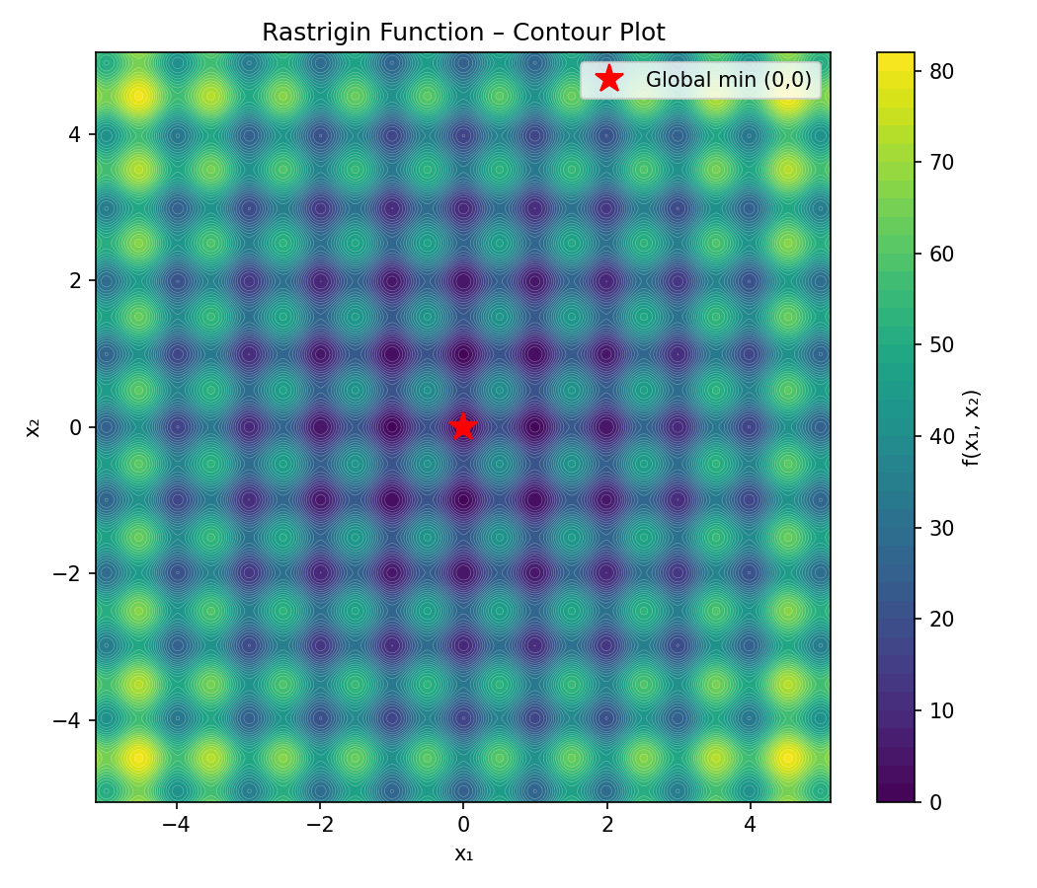
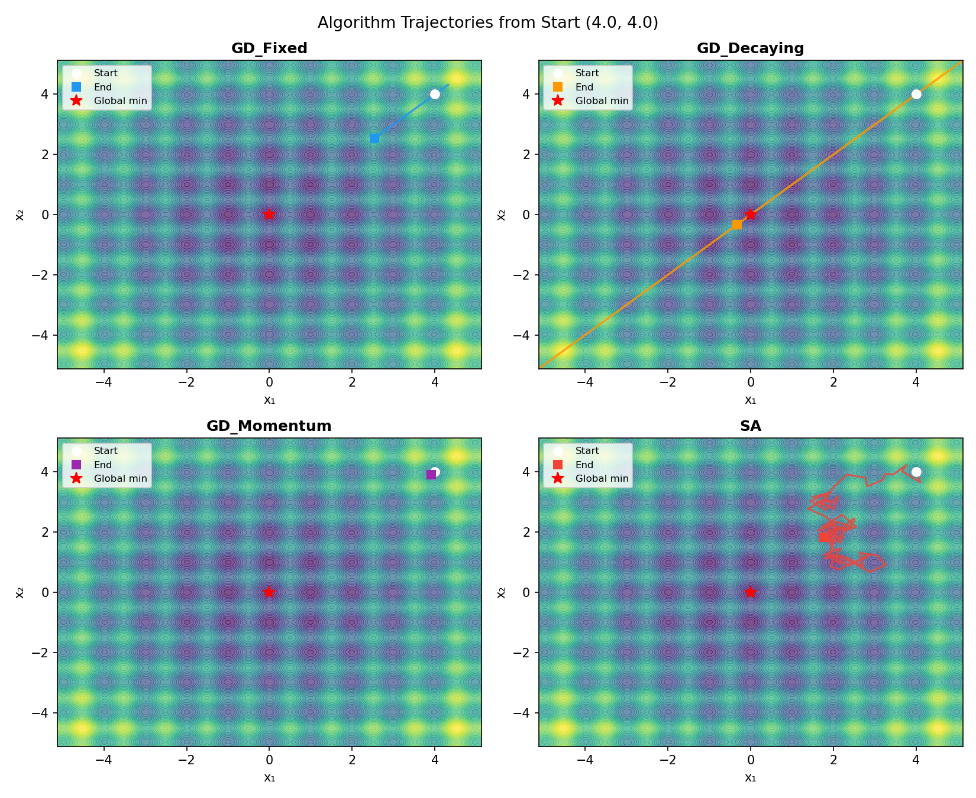
Landscape And Search Behavior
The contour plot shows the highly multimodal landscape around the global minimum.
Trajectory plots show the contrast between direct descent and exploratory stochastic search.

Slide 7
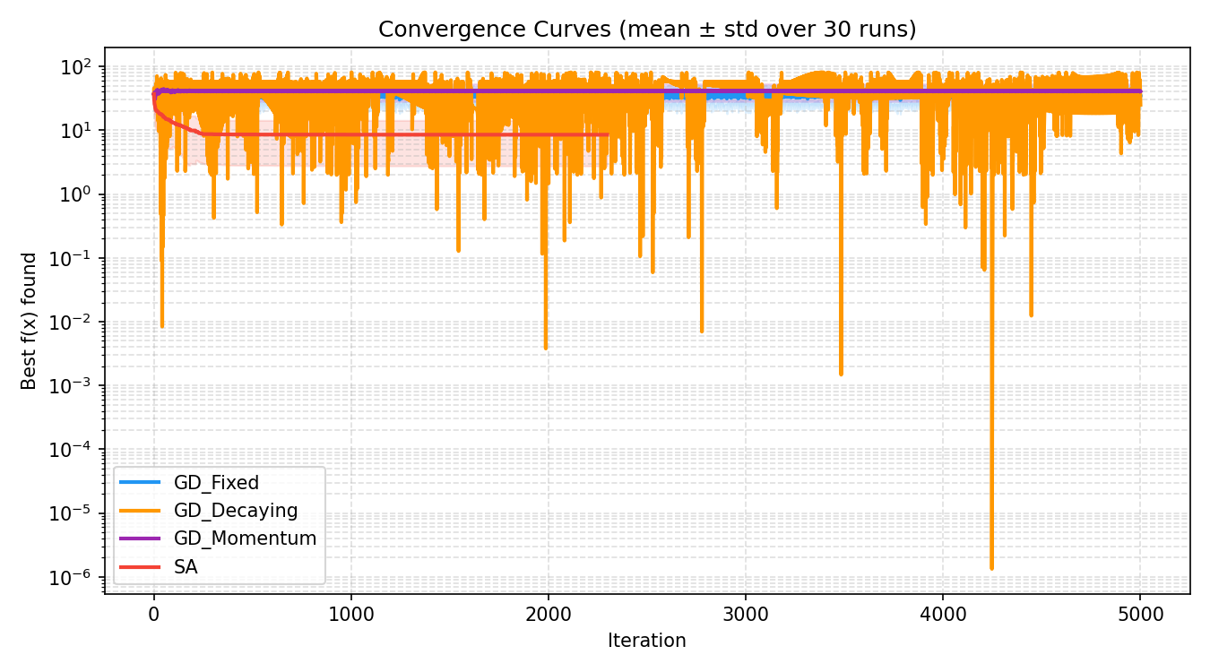
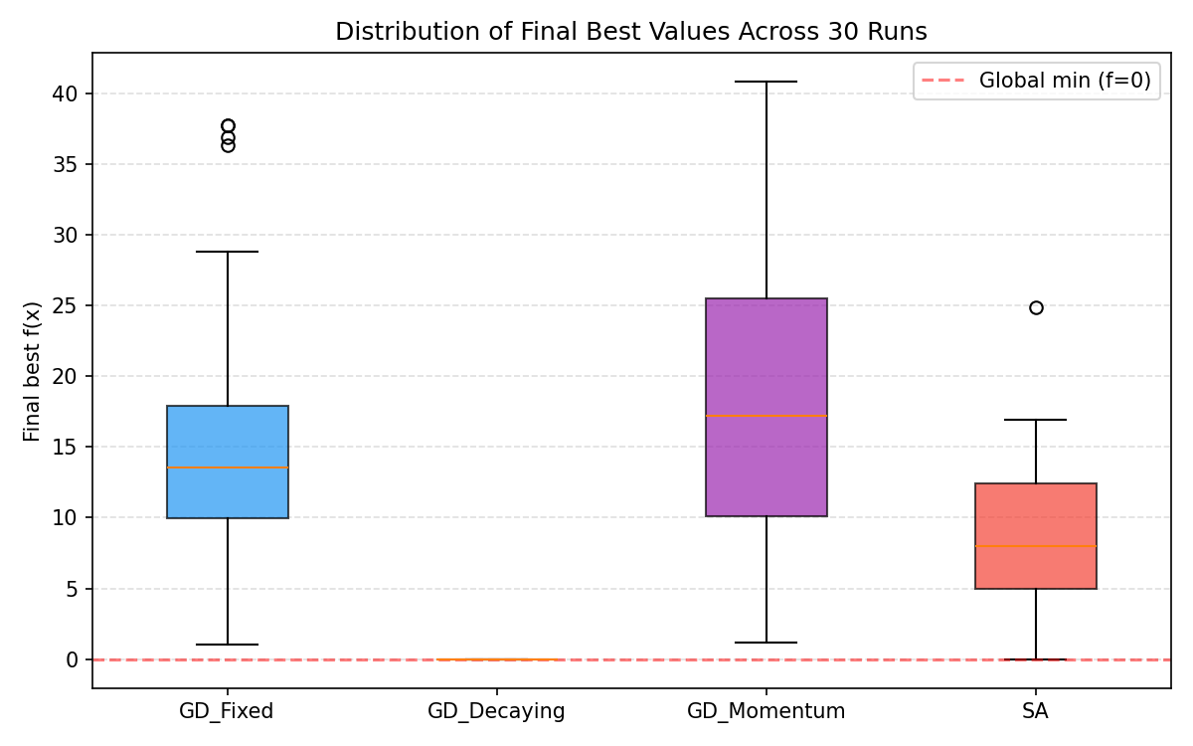
Convergence And Result Distribution
Decaying GD converged consistently to near-zero values across all runs.
Fixed GD and momentum were less reliable, while SA often got close without crossing the strict success threshold.

Slide 8
Conclusions And Future Work
The best overall performer was decaying gradient descent, which achieved 30/30 successes with mean f approximately 1e-6.
Simulated annealing improved exploration and found near-optimal points, but under this schedule it did not satisfy the strict success threshold in any run.
Fixed learning rate and momentum were vulnerable to local minima despite reasonable runtimes.
Future work: tune the annealing schedule, test additional benchmark functions, and examine higher-dimensional Rastrigin settings.

